Slide 1
The Russo-Japanese War
The Russo-Japanese War of 1904-1905 changed the power relationships in Asia dramatically in favor of the victorious Japanese. It also led the Russians to change their primary diplomatic focus to Europe, especially the Balkans. Germany and its principle ally Austria-Hungary saw this new shift in Russian emphasis as a potential threat, as did the Ottoman Empire.

Slide 2
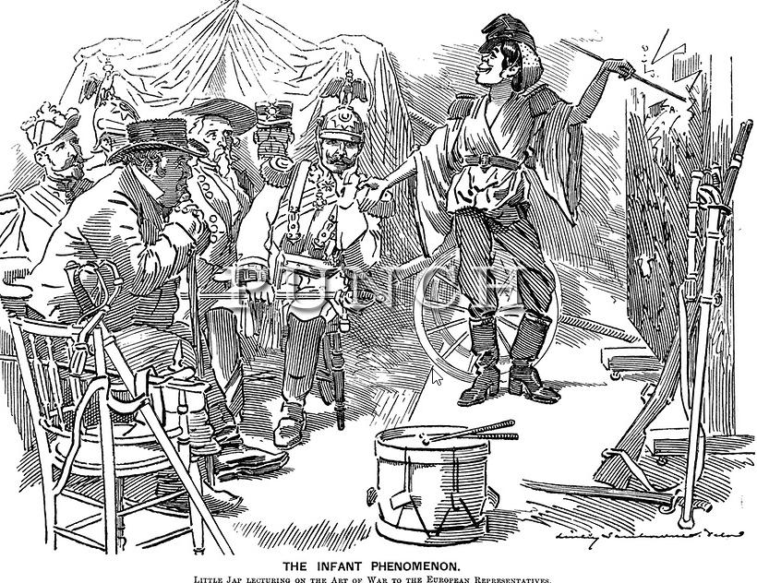
The Growth of Japan
Since its “opening” to the west in the 1860s, Japan had undergone a massive program of modernization that changed the balance of power in Asia. Japan’s growth worried China, Russia, and imperial powers like Britain. A modern, industrial Japan defeated a larger, but still mostly rural, China in a war in 1894-1895. Japan’s victory in that war proved that it would be a force in Asia.
http://punch.photoshelter.com/image?&_bqG=308&_bqH=eJxNzssKwjAQBdC_6aabWmyRQhZxGmF8JJKkiKtQpdZqrdL6QL_eRHzNJucS5jLwCC9hf7.Ajhb36FRzFj2qIAa43pJeOIiTKAiSXmAnQZMqIHlT1ke_LNpD3vhtdc3r9u69vgzlKdlYA.olsa_SVDMHEBnXcmlQCRdRGcmmjCqWvuP8PwuJjNtVFPzVIqQmkvKJdaaYNJiSzB20G..qSK6aGkvPwNCgrSHnD7Mv5ejHmSMFTboib9dbD1zbEy6LTt4-&GI_ID=

Slide 3
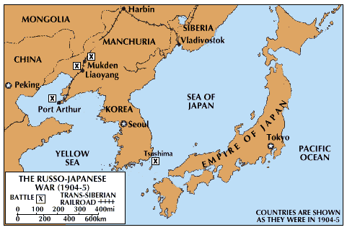
Outbreak of the War
The causes of the war were in Asia, where Russia and Japan vied for control of Manchuria and Korea. The rapid decline of the Chinese Qing dynasty left a power vacuum in northeast Asia that both the Russians and Japanese sought to fill.

Slide 4
European Impacts
Although the war was about Asian issues, it had the potential to impact Europe as well, primarily because of the treaty between Britain and Japan. A naval incident in the North Sea between Russian and British ships did temporarily increase tensions, but they passed without further violence.
British/Russian tensions were high because of the rivalry between the two powers for influence in Persia and Afghanistan.
The Anglo-Japanese Alliance, 1902 (Some Key Points)
Article 1
The High Contracting parties, having mutually recognized the independence of China and Korea, declare themselves to be entirely uninfluenced by aggressive tendencies in either country, having in view, however, their special interests, of which those of Great Britain relate principally to China, whilst Japan, in addition to the interests which she possesses in China, is interested in a peculiar degree, politically as well as commercially and industrially in Korea, the High Contracting parties recognize that it will be admissible for either of them to take such measures as may be indispensable in order to safeguard those interests if threatened either by the aggressive action of any other Power, or by disturbances arising in China or Korea, and necessitating the intervention of either of the High Contracting parties for the protection of the lives and properties of its subjects.
Article 2
Declaration of neutrality if either signatory becomes involved in war through Article 1.
Article 3
Promise of support if either signatory becomes involved in war with more than one Power.
Article 4
Signatories promise not to enter into separate agreements with other Powers to the prejudice of this alliance.

Slide 5
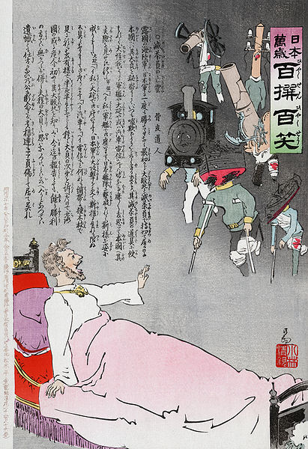
Russia Defeated
Japanese forces completely destroyed Russian forces on both land and sea. The trench warfare at the Battle of Mukden (then the largest battle in history) foreshadowed the trenches of World War I. In this Japanese woodcut, Czar Nicholas awakens from a nightmare to see all of his instruments of power destroyed.

Slide 6
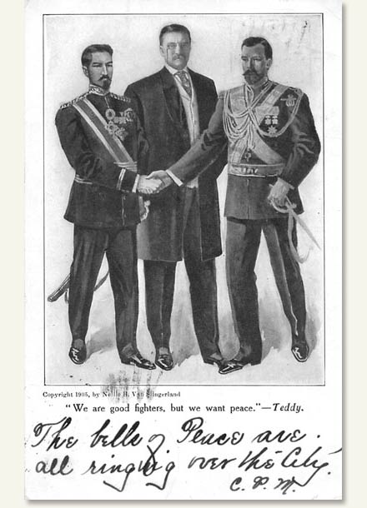
Treaty of Portsmouth
President Theodore Roosevelt won America’s first Nobel Peace Prize for his role in ending the war. Japan emerged with control of Manchuria and Korea as well as a vastly increased international standing. Russia faced the challenge of rebuilding its armed forces as well as political unrest at home.

Slide 7
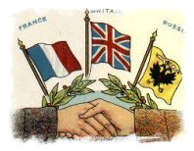
Impacts
The Russians looked to their French allies to fund railroad improvements and arms purchases. They embarked on a massive program designed to give Russia a fully modern military with a transportation network to support it by 1917. Russia also signed an alliance with Britain in 1907 that ended the rivalry in the Middle East in order to help Russia focus on other problems.

